Slide 1

Methylene Blue for Ifosfamide Encephalopathy

Slide 2
Let’s start with Methylene Blue

Slide 3
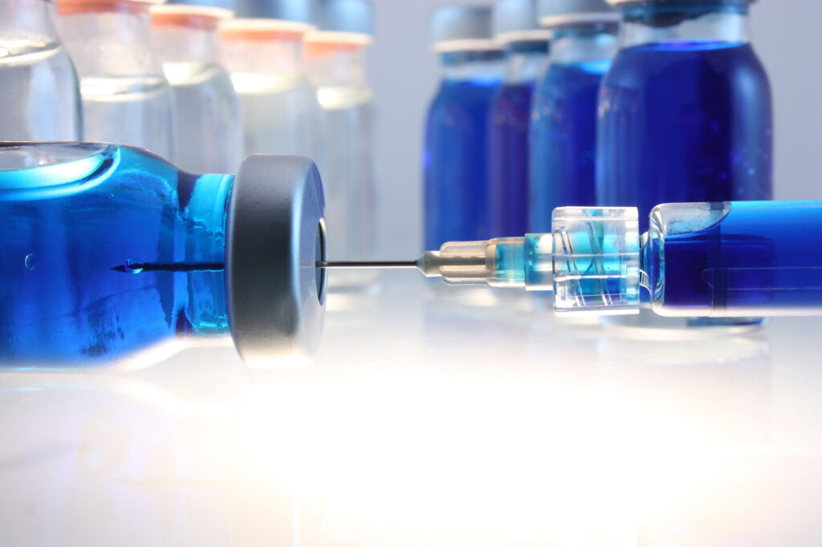
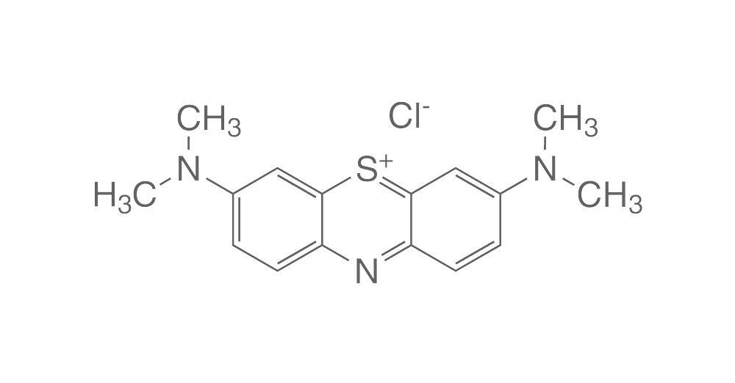
Methylene Blue
It’s a blue dye
Structure is essential to function

Slide 4
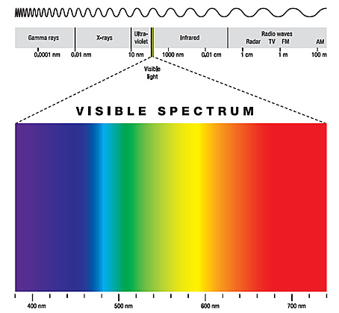
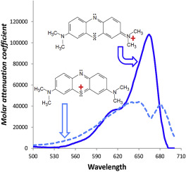
Methylene blue is a dye
Essentially no absorbance below 500nm

Slide 5
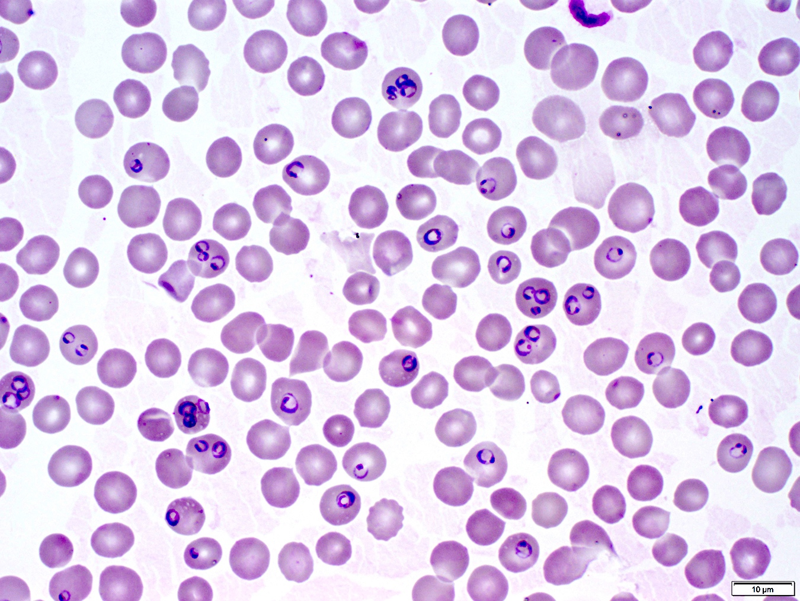
Methylene blue is a dye
Classically, we use Giemsa stain to stain plasmodium spp. and detect malaria Giemsa stain is just methylene blue + eosin
This discovery won a Nobel Prize
Also stains GAGs, some protein aggregates, et.

Slide 6
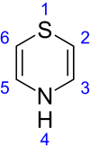
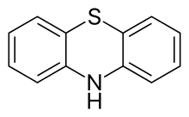
MB Structure is essential to understanding function
Methylene blue
is a thiazine
But more specifically, a phenothyazine

Slide 7
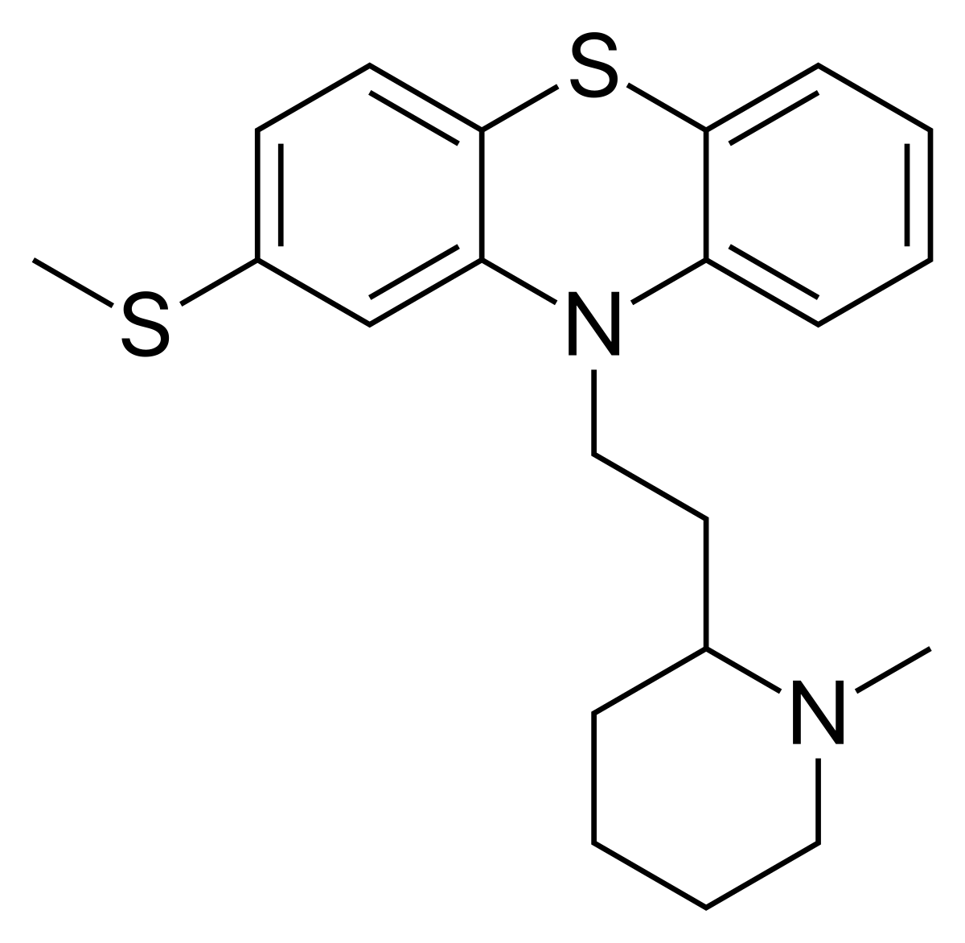
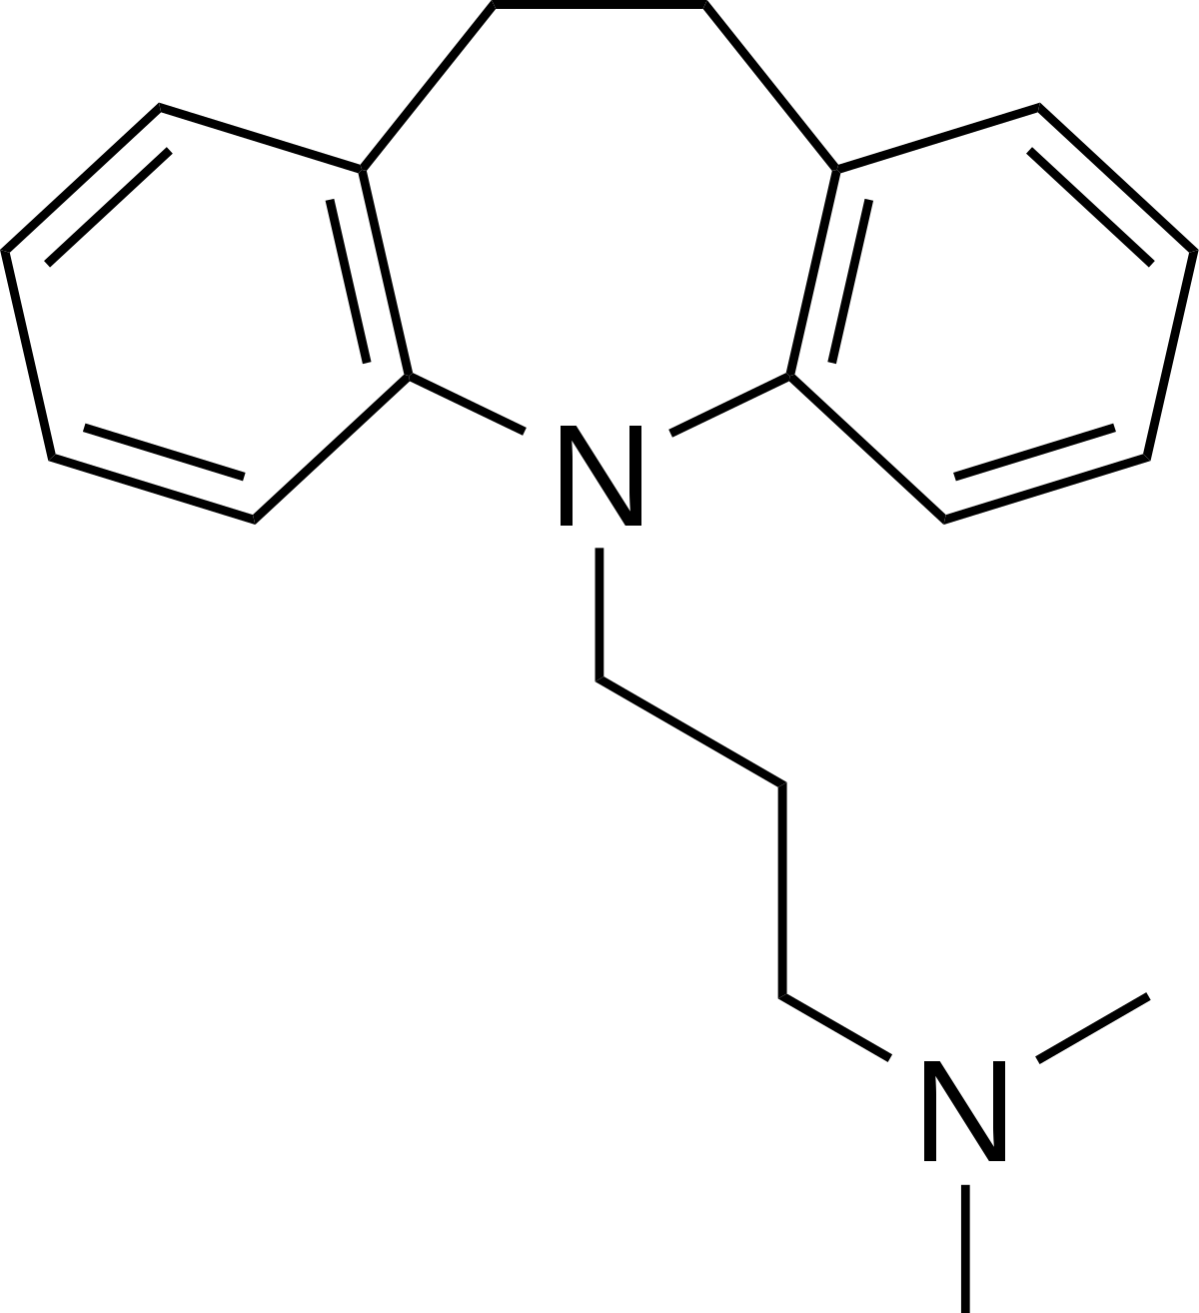
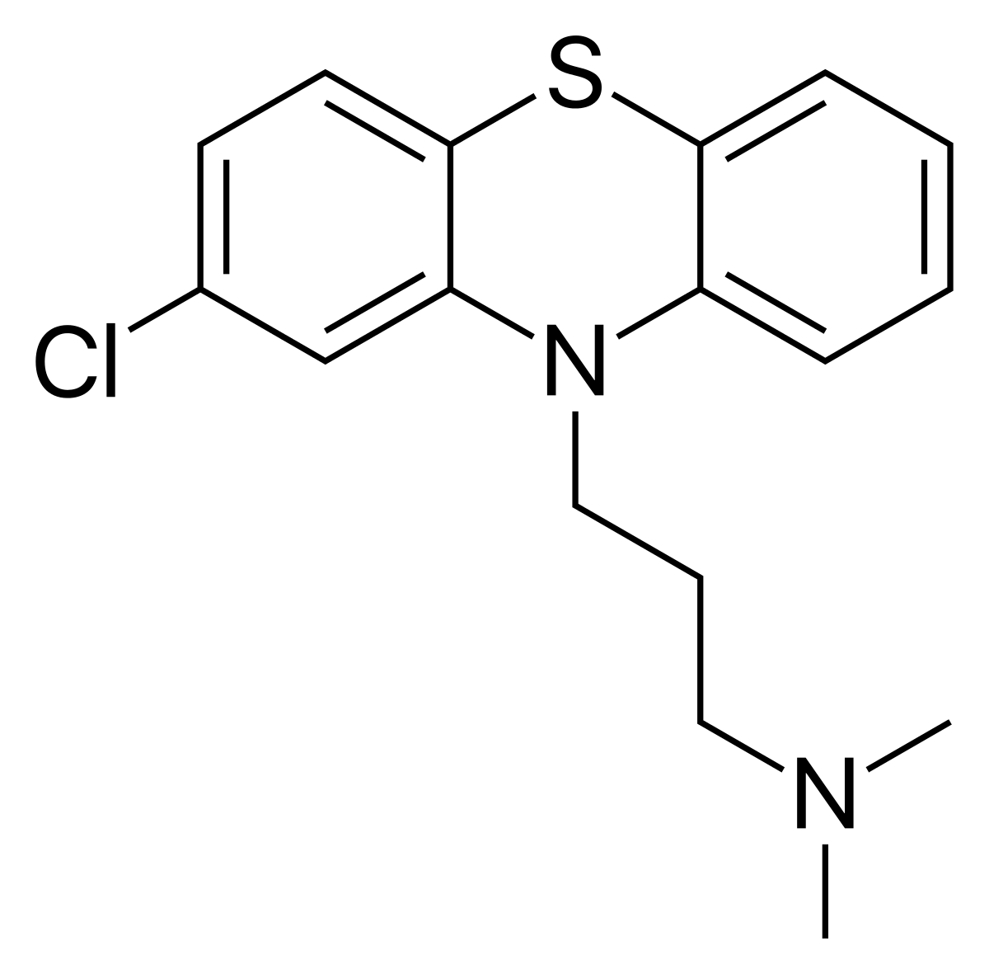
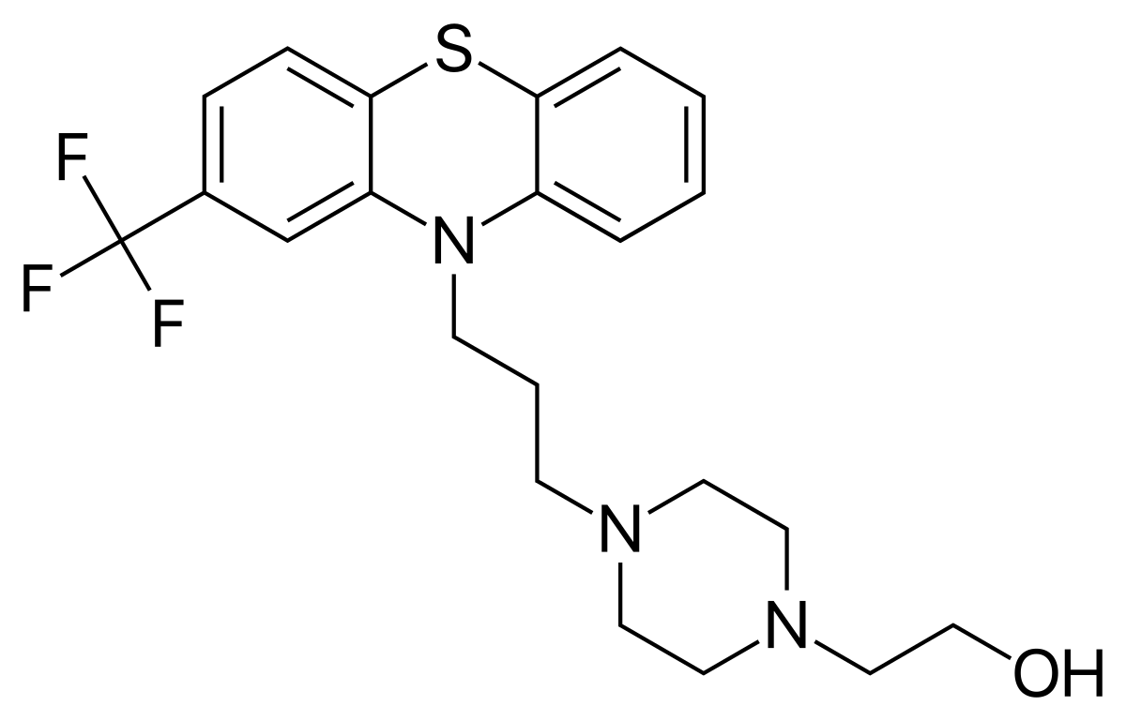
phenothiazine
thioridazine*
tricyclic antidepressants!
Chlorpromazine*
fluphenazine
TCAs are some of the dirtiest drugs imaginable
Notes:
Withdrawn from market in 2005 because it caused severe arrhythmias

Slide 8
One scenario where we understand quite well how methylene blue works from in vitro experiments:
Methemoglobinemia

Slide 9
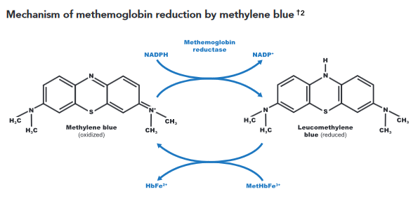
Redox Reactions: LEO goes GER
(sustained via hexose monophosphate shunt)
desired reaction in methemoglobinemia

Slide 10
Ifosfamide Encephalopathy

Slide 11
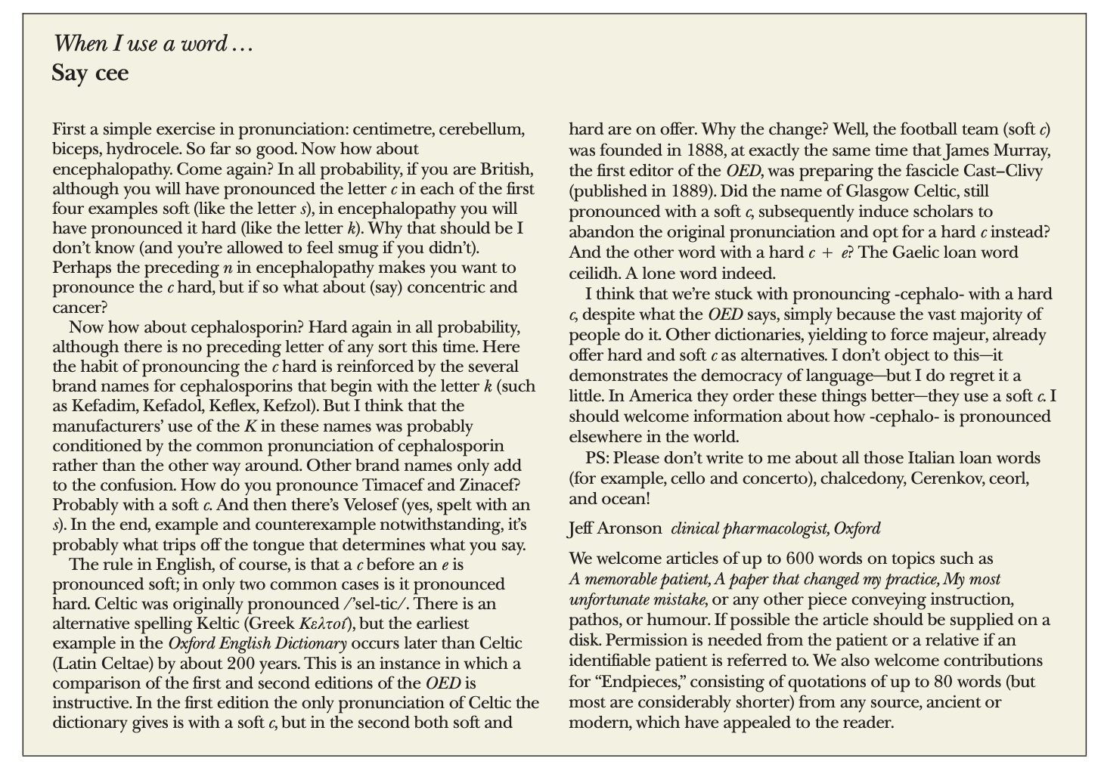

Ifosfamide Encephalopathy
BMJ 2000
Enkephalos, brain (Greek) Pathos, suffering/dz (Greek)
Washington DC 1977

Slide 12
Clinical features of ifosfamide encephalopathy
Overall encephalopathy incidence: 5-35%*
Given encephalopathy:
Confusion (>80%) – spectrum from lethargy to delirium
Psychosis and hallucinations (30%)
Incontinence and muscle twitching (10%)
Less than 5% each of:
Extrapyramidal symptoms
Seizures
Cranial nerve findings
Dysarthria

Slide 13
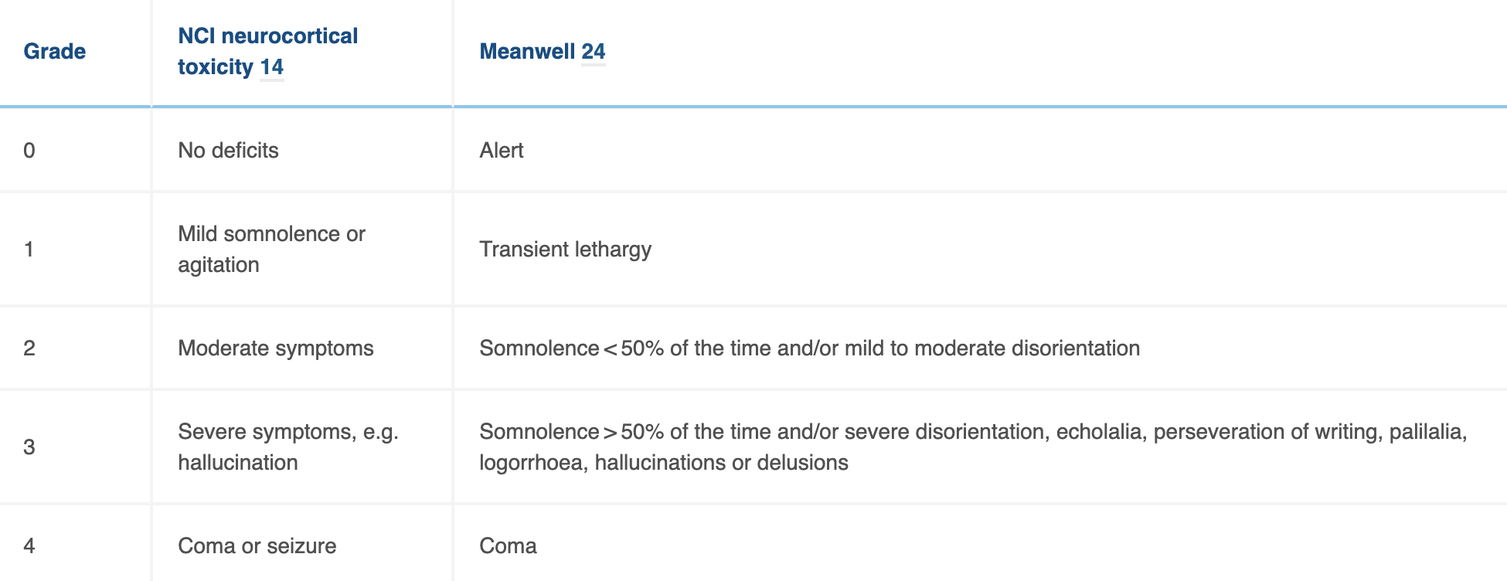
NCI Grading Scale

Slide 14
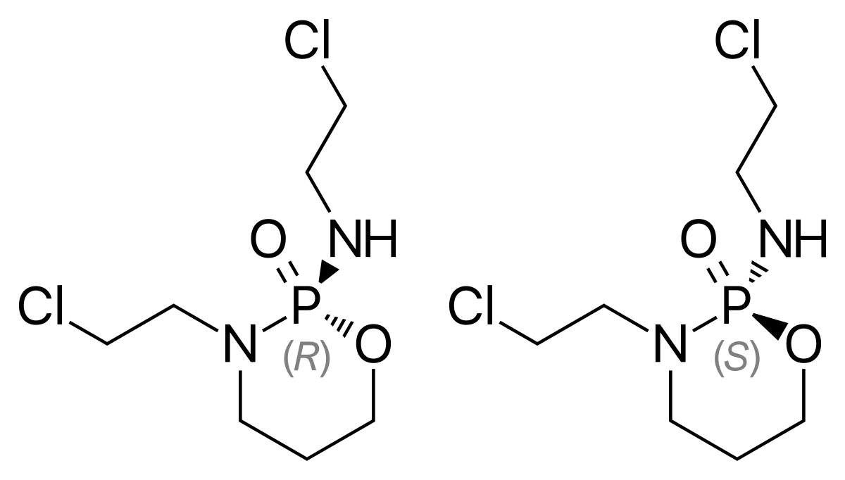
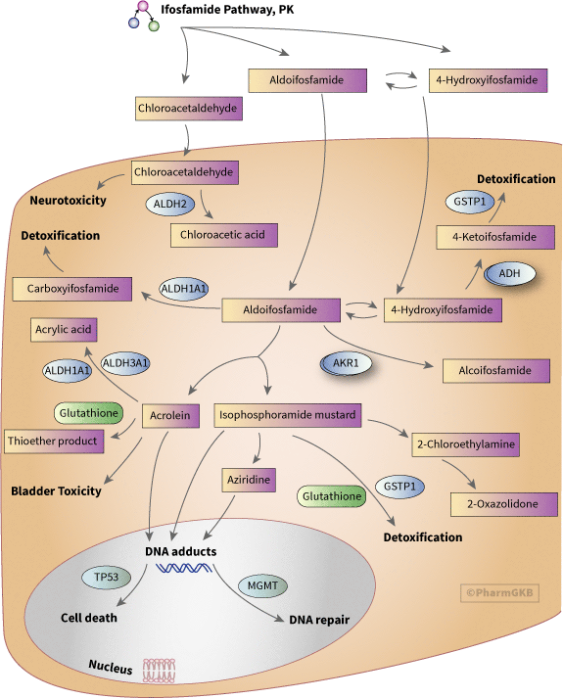

To understand how methylene blue might help treat ifosfamide encephalopathy…
Ifosfamide
We should first understand how ifosfamide produces encephalopathy

Slide 15
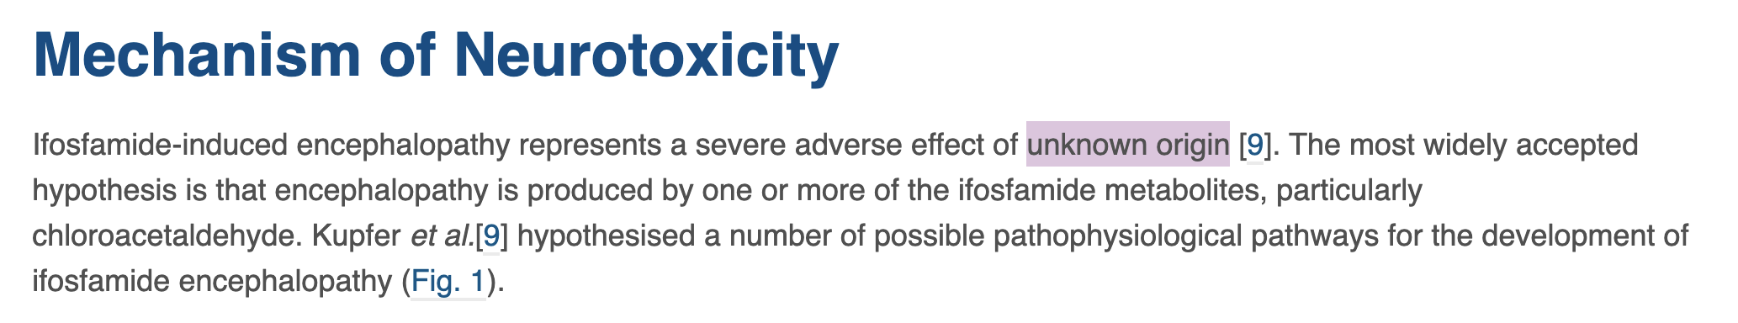
To understand how methylene blue might help treat ifosfamide encephalopathy, we should know how ifosfamide produces encephalopathy
Clinical oncology 2020

Slide 16
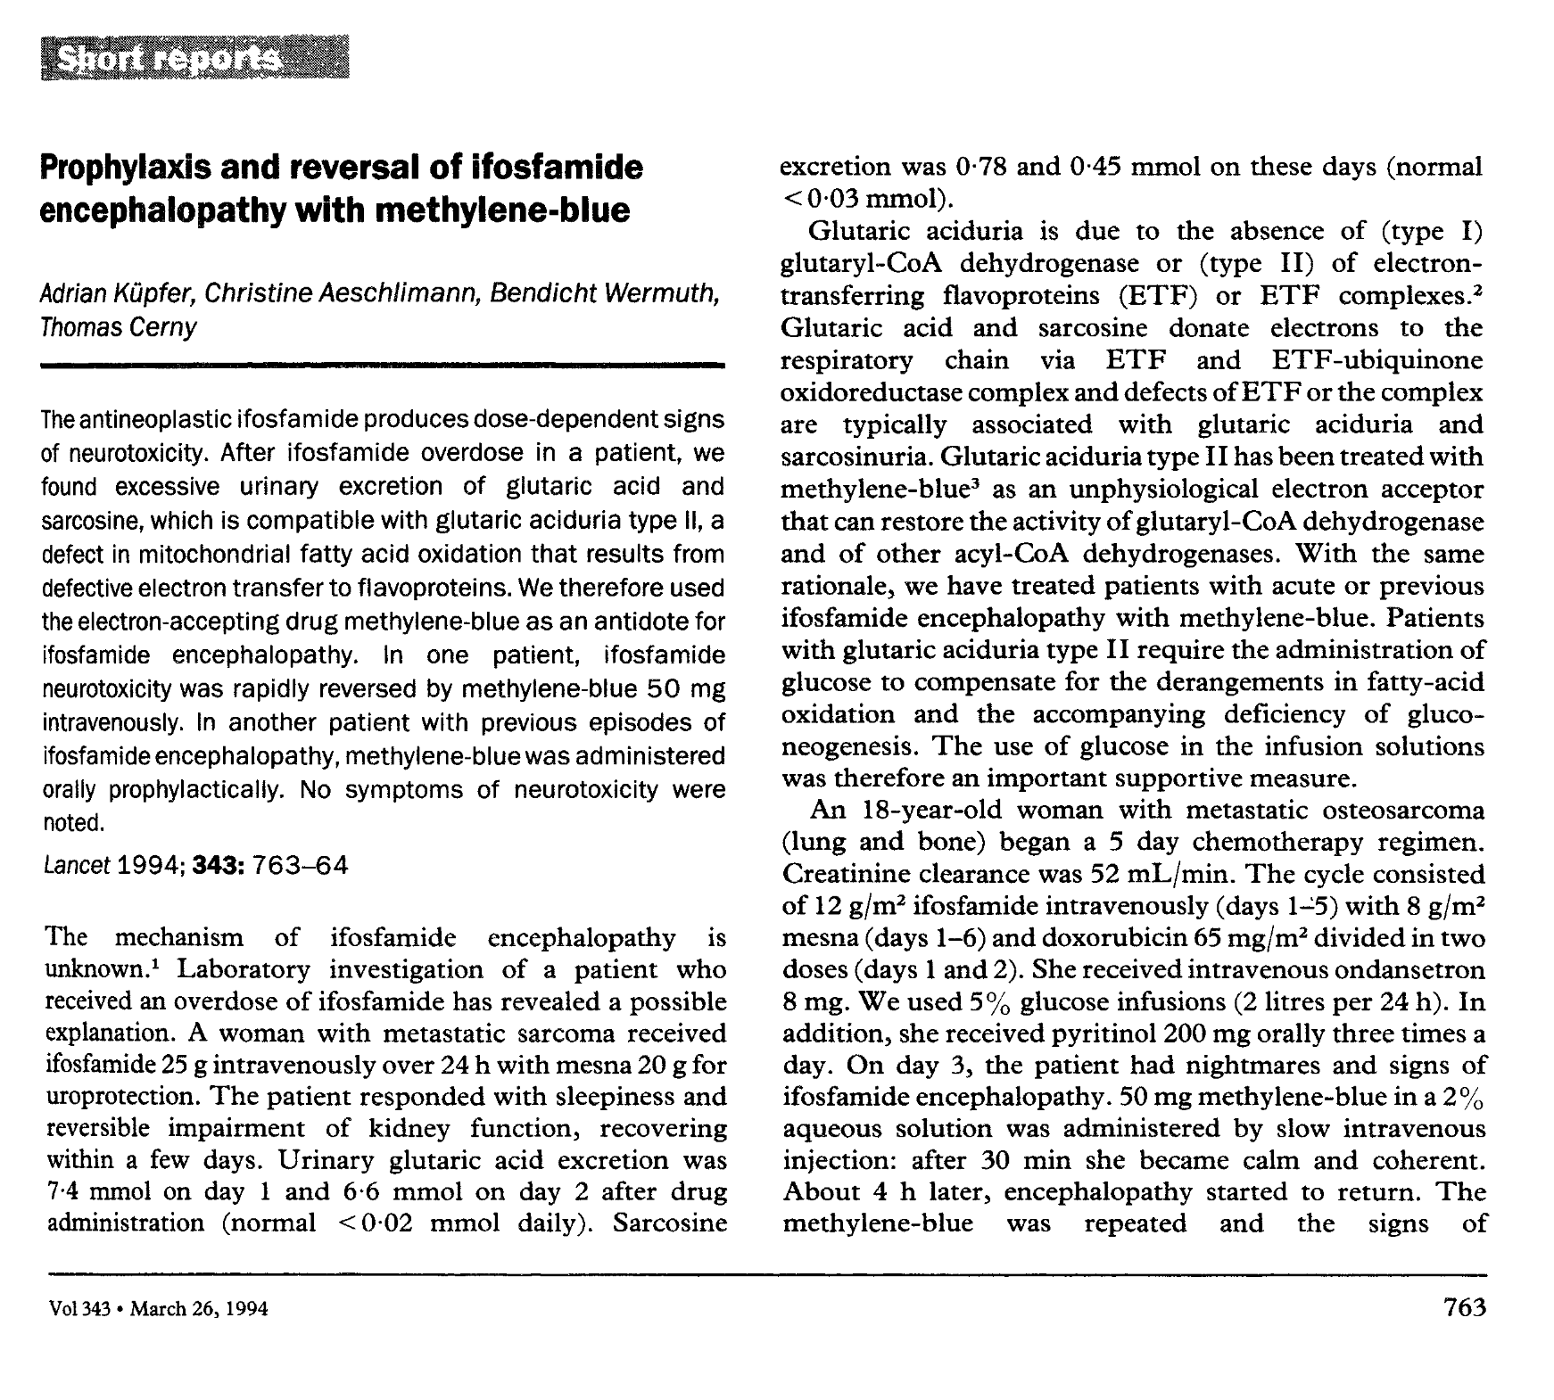
Original Rationale for Methylene Blue
Glutaric acid noted in patient’s urine
400 word report in Lancet, 1994

Slide 17

methylene blue is widely bioactive
Good intuition for 2020
many straightforward mechanistic explanations
are likely to be incomplete or wrong

Slide 18
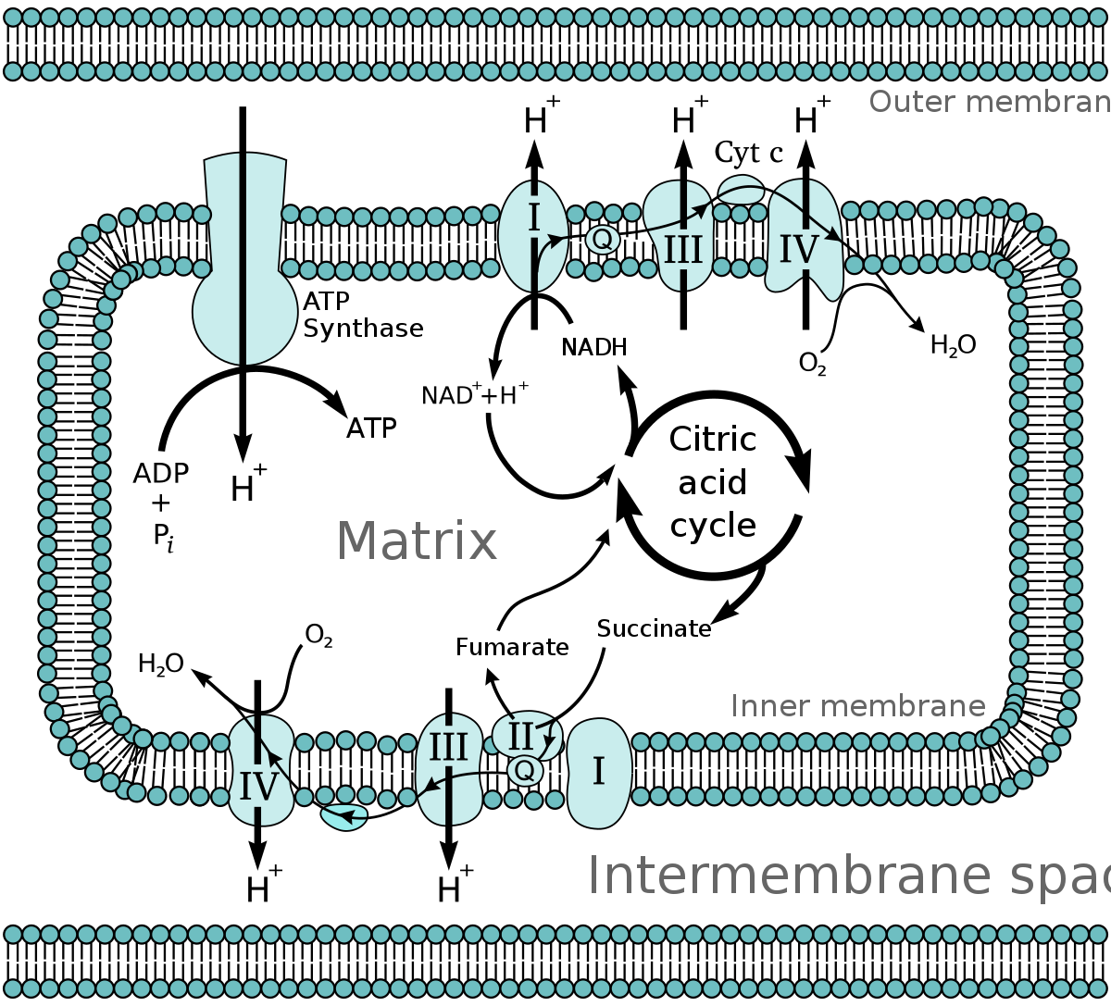
Electron transport chain

Slide 19
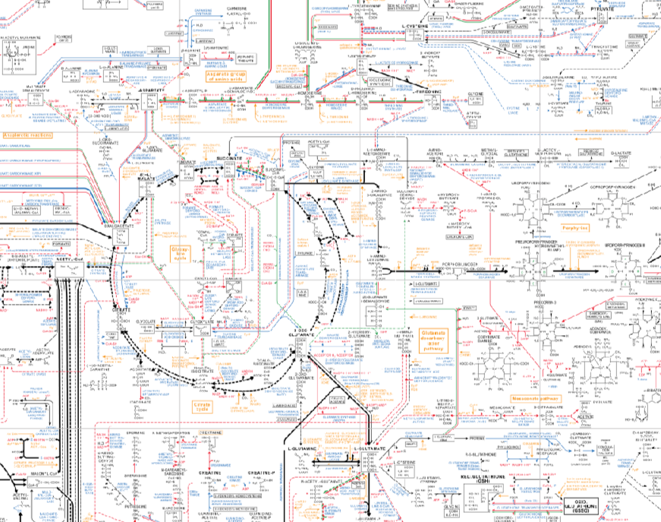
Reality (in the 1970s, even):

Slide 20
Should exercise some humility when trying to understand why methylene blue might help ifosfamide toxicity
Takeaway:

Slide 21
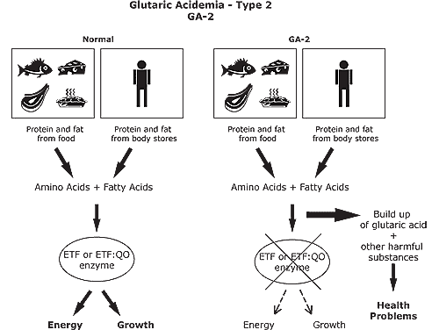
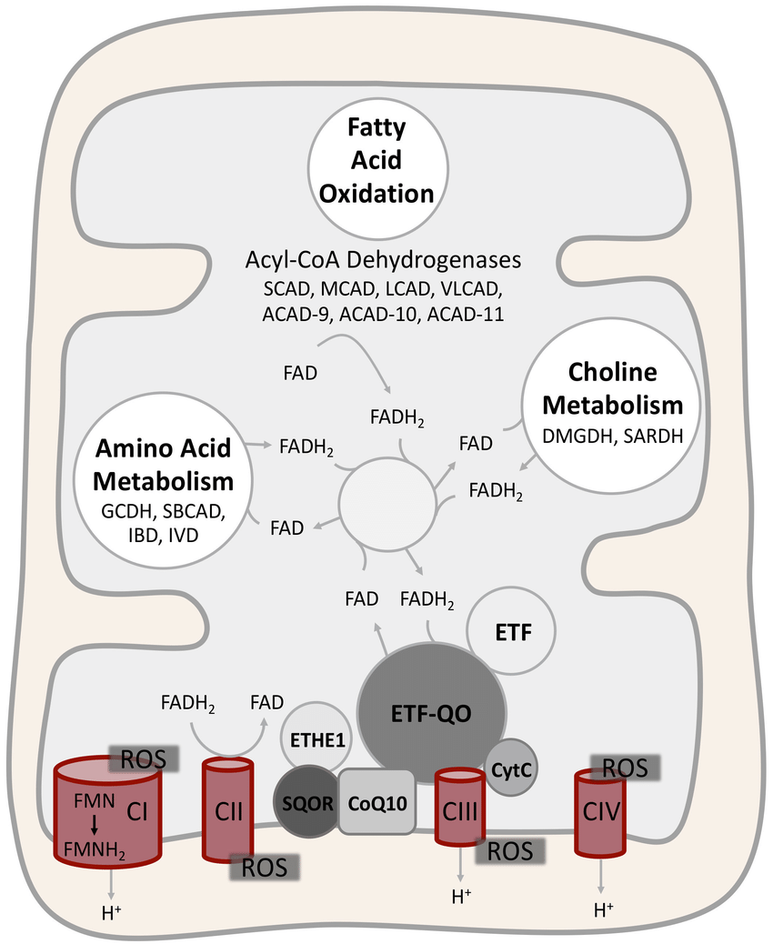
Glutaric Acidemia, Type II
ETC
Glutaric aciduria is a feature of Glutaric acidemia :
Inactivating mutations in electron transport chain proteins ETFA or ETFB (electron transport flaviproteins)
or ETFDH (electron transfer flavoprotein dehydrogenase)
“We know methylene blue is an electron acceptor, maybe we can use it to replace lost electron acceptor function”
n.b. remember ETC is not a linear chain at all

Slide 22
Rationale:
In glutaric acidemia type II, you are functionally just missing an electron acceptor ➔ Methylene blue is an electron acceptor!

Slide 23
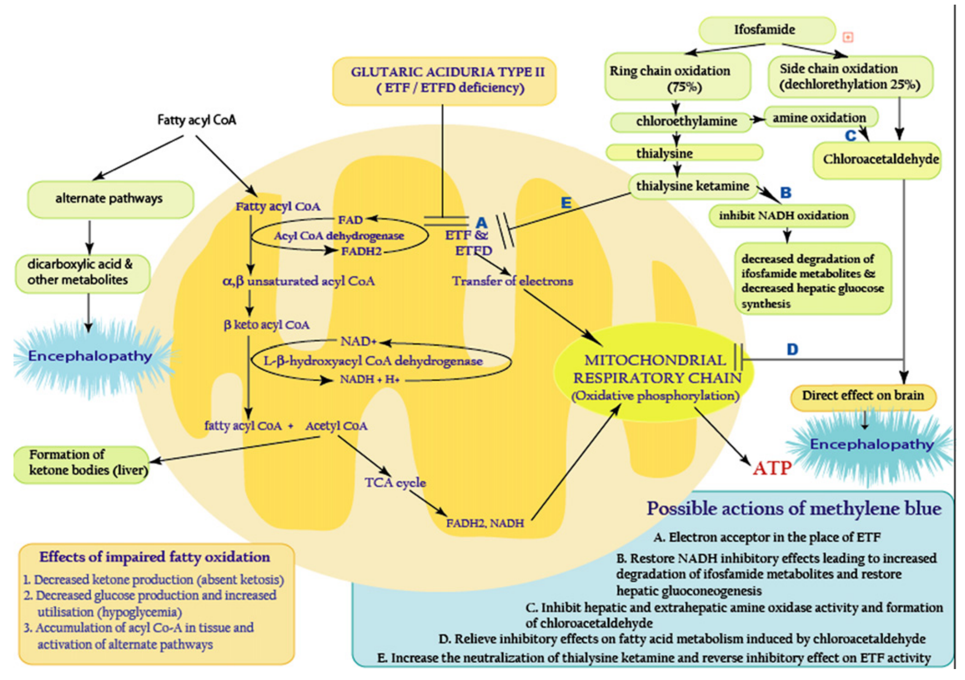

Slide 24
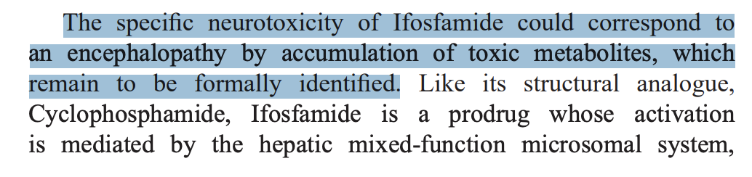
In Reality:
Mechanism is far more complex and likely multifactorial
How we get from chloracetaldehyde (which is controversial) to disruption of the ETC and neurotoxicity is complex and poorly understood
Methylene blue may function as an electron acceptor indirectly and also has pleiotropic effects

Slide 25
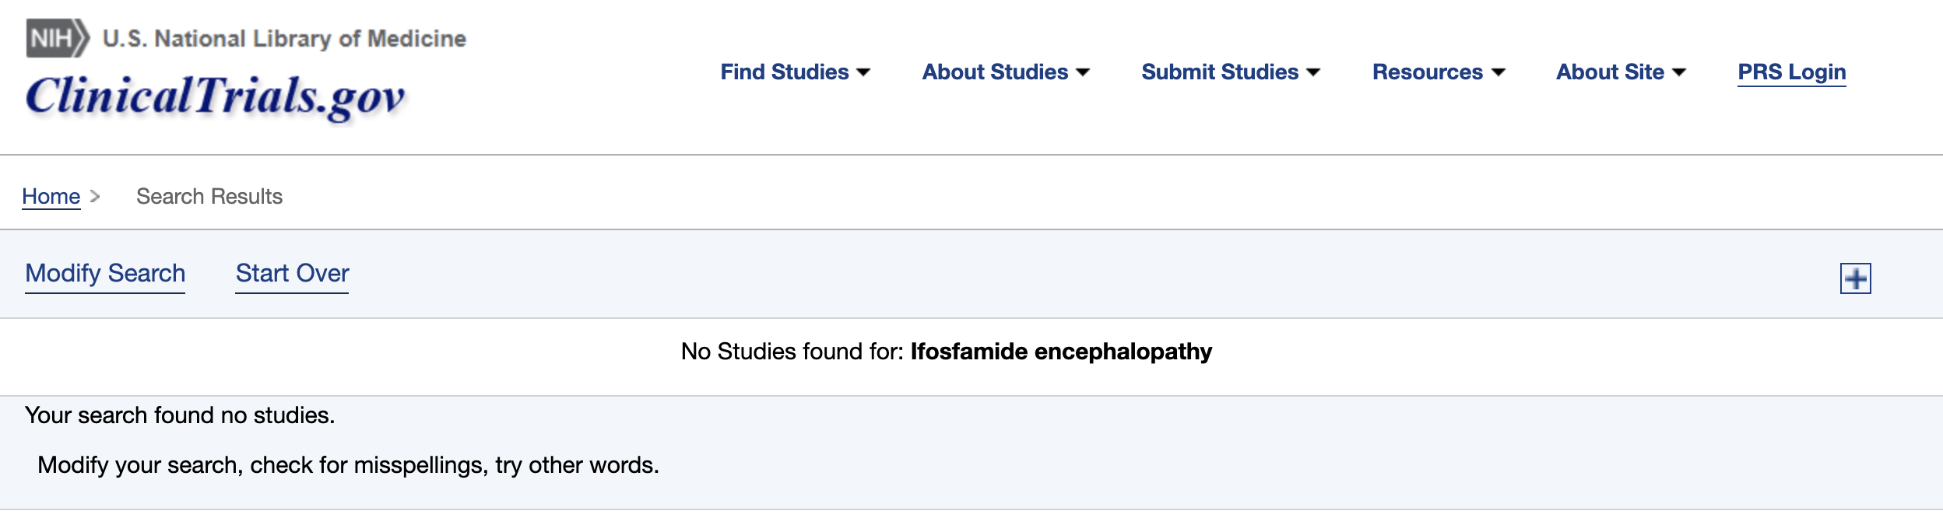
How effective is it?

Slide 26
Review of 224 methylene blue trials on clinicaltrials.gov
Example conditions tested:
Sepsis
Onchomycosis
Malaria
Alzheimer Disease
Bipolar
I am not aware of any RCTs for MB in Ifosfamide encephalopathy

Slide 27
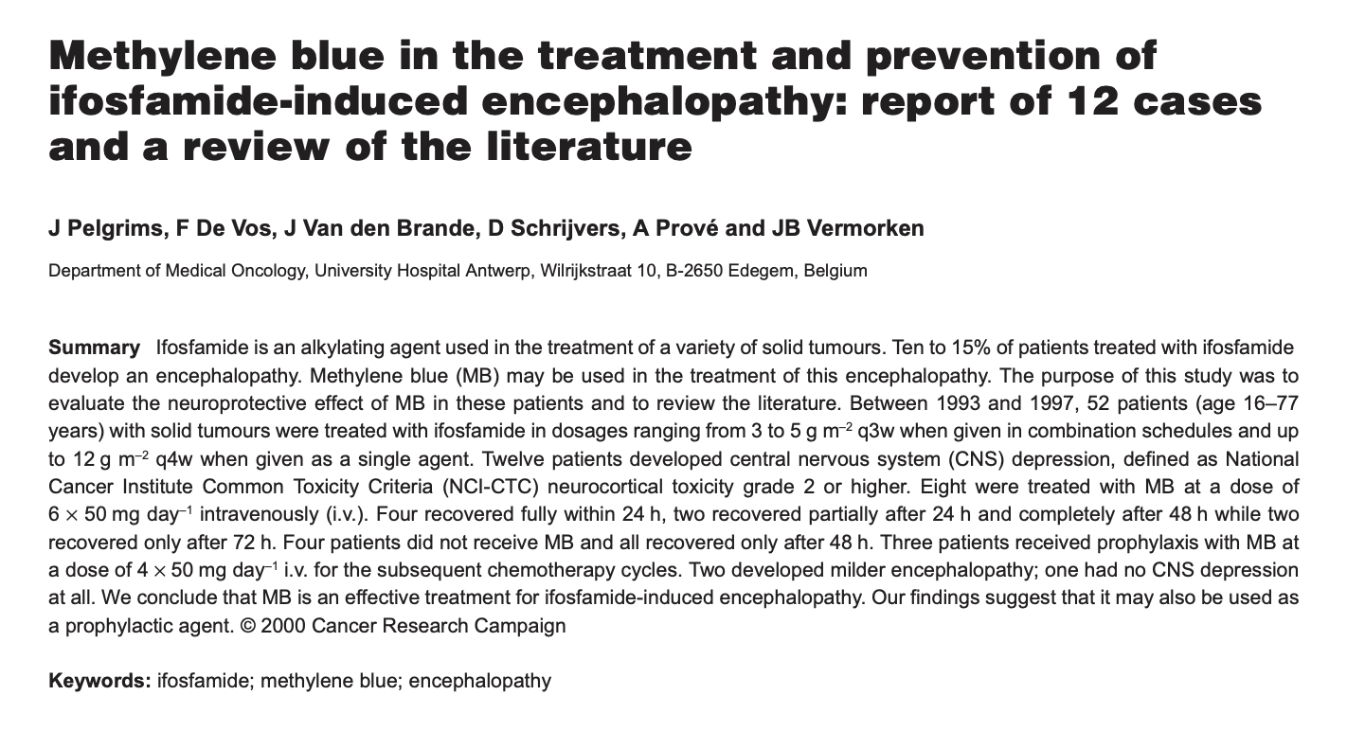
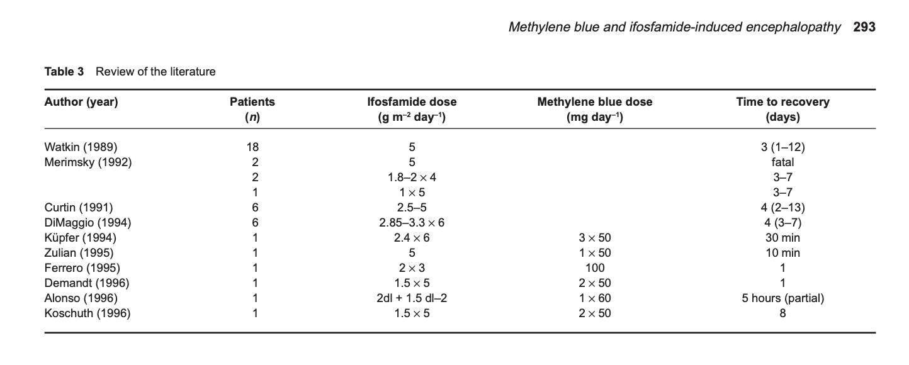
Evidence is
rather weak

Slide 28
Ifosfamide
MB Mechanism
MB Efficacy
We don’t really know why ifosfamide is neurotoxic, but we have several rational hypotheses
We don’t know how methylene blue ameloriates ifosfamide neurotoxicity, but we have several rational hypotheses centered upon role as electron acceptor
Evidence for the efficacy of MB in ifosfamide-induced encephalopathy is weak and generally based upon small case series at best

Slide 29
Man only likes to count his troubles; he doesn't calculate his happiness
– Crime and Punishment
We don’t know exactly why it works, but it seems like could work and we give it anyway

Slide 30
Questions?

Slide 31
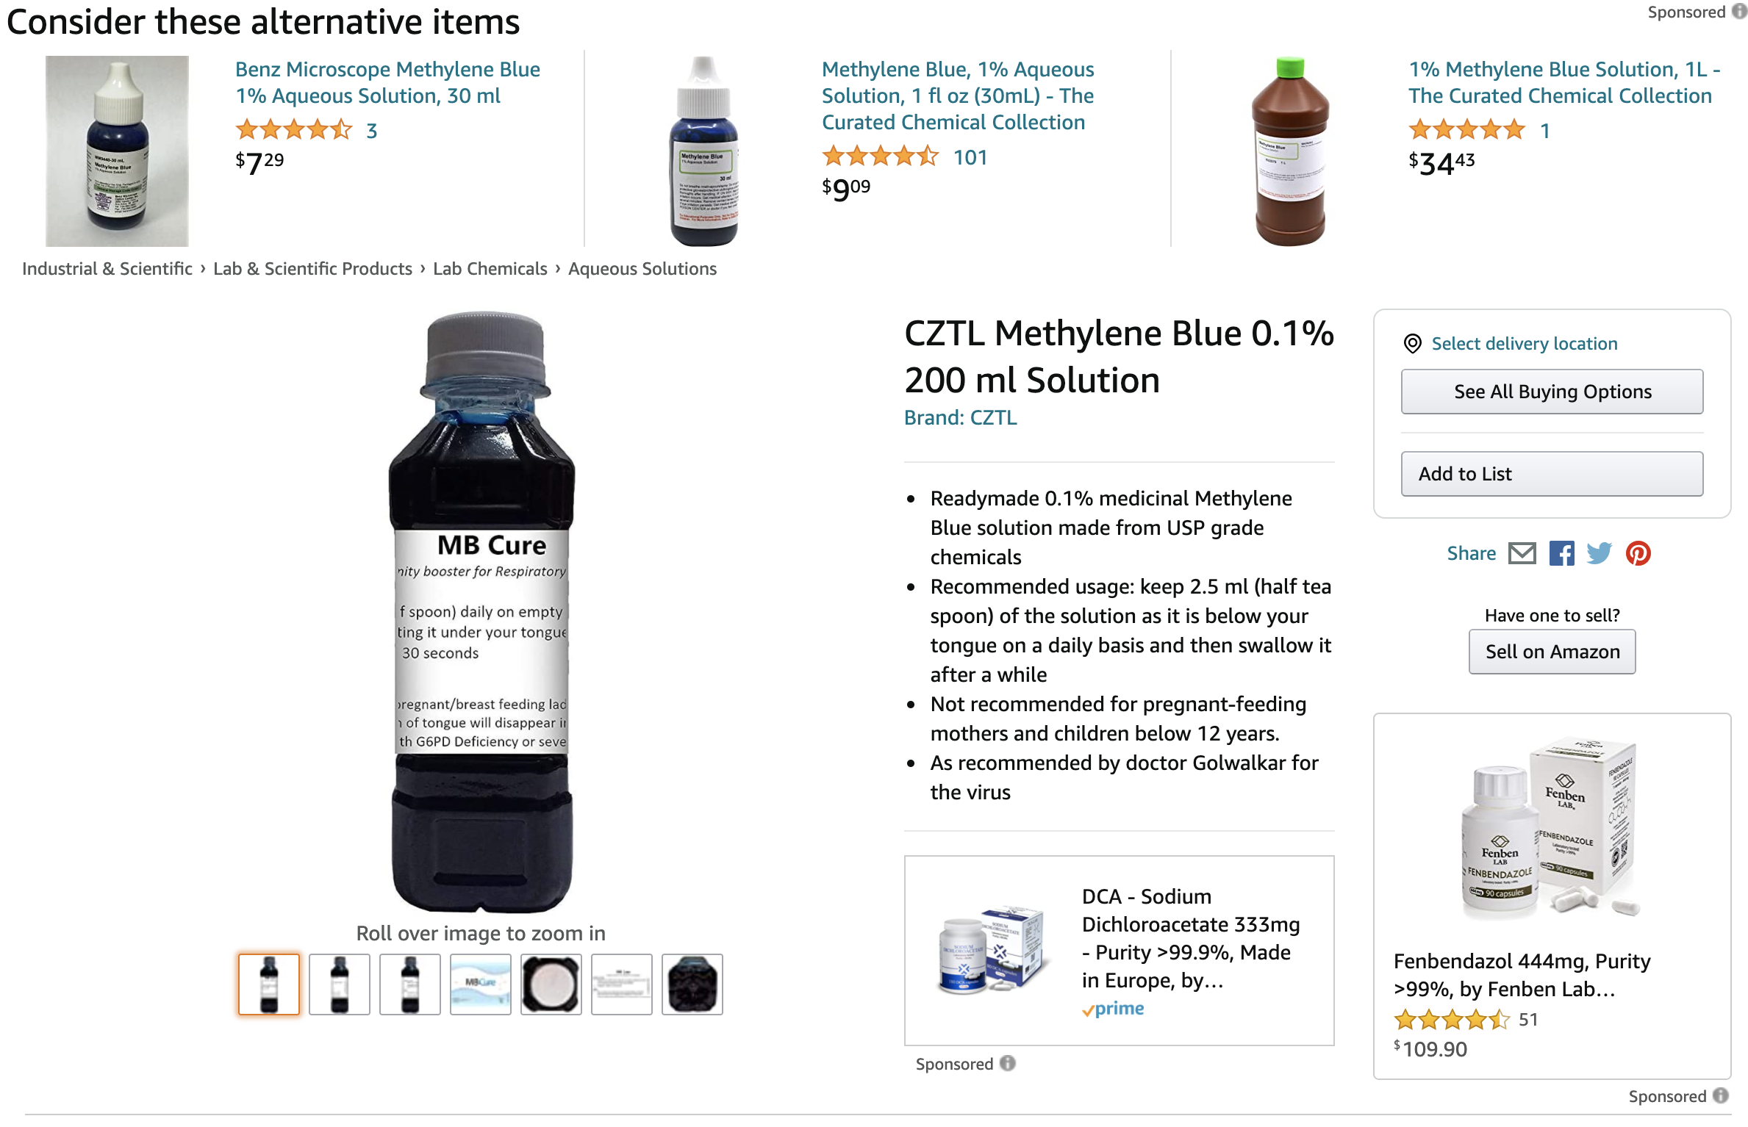

Slide 32
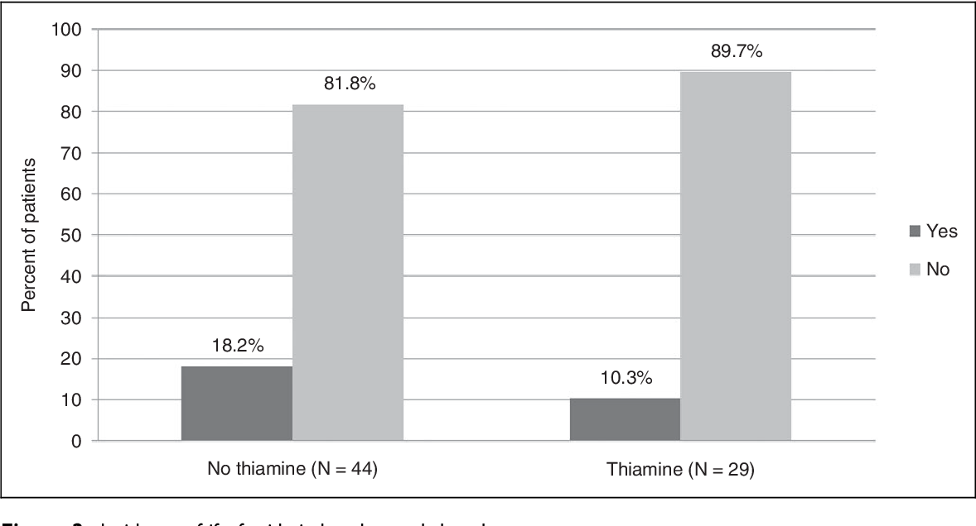
Thiamine prophylaxis?
Notes:
https://clincancerres.aacrjournals.org/content/9/12/4636.full-text.pdf

